Slide 1
Village of Liverpool Tree Committee
OVERVIEW & STEWARDSHIP OPPORTUNITIES

Slide 2
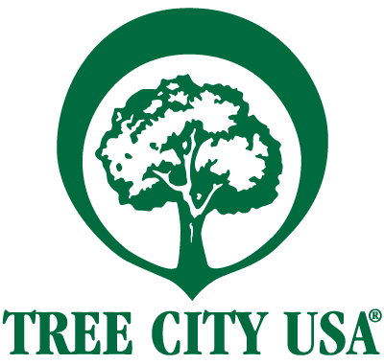
Who We Are
The Village of Liverpool appointed a Tree Committee in January 2017 for the purpose of maintaining the health and maintenance of existing trees and the planting of new trees and shrubs on Village of Liverpool property.
The Tree Ordinance (chapter 353 of Village code) was officially adopted by the Village of Liverpool Board of Trustees on 4-11-2019 and is available on the Village website.
The Tree Committee is also responsible for the annual Arbor Day celebration, development of the Village’s Forest Management Plan, and implementation of the Tree Ordinance.
The Tree Committee was awarded Tree City USA designation in December 2019 by the Arbor Day Foundation, and participates in the New York Releaf Program.

Slide 3
Who We Are Continued
The committee is an advisory committee to the Village Board of Trustees.
The committee has 5 members, including residents of the village or others persons with a qualification in arboriculture, horticulture, landscape design or other environmental qualification and an interest in the village.
At least 3 members of the committee should be residents of the village.
Interested in participating? Please let us know!

Slide 4
Plans for Our Community Forest
Implement the Village of Liverpool’s Urban Forestry Management Plan Goals:
Improve Urban Forest Quality
By 2025, complete the priority maintenance identified in the tree inventory and re-inventory every 10 years.
Increase Urban Forest Quantity
1:1 replacement goal
Increased tree diversity
Education and Outreach
Tree Steward program
Planting demonstrations
FAQ
Why is removal necessary if the goal is expanding the community forest?
The Committee is looking to create a healthy tree canopy. Removal of trees is necessary in the Village ROW if the tree poses a potential public safety risk or hazard; causes an unsafe condition; is injurious to sewers, electric power lines, gas lines, waterlines or other public improvements, and the situation cannot be mitigated by other means; is affected with any injurious fungus, insect or pest that threatens municipal trees.
What are the benefits of tree canopy expansion?
Reduction of summer peak temperatures and air pollution; enhancement of property values; improved wildlife habitat; aesthetic benefits; and improved social ties among neighbors.
Notes:
What has been planted so far (2021)
Briefly explain current CDBG grant and upcoming plans for fall planting – areas involved, how the planting will work, how we need volunteers to help
Other potential grants and planting plans, spring 2023 planting plans – Arbor Day

Slide 5
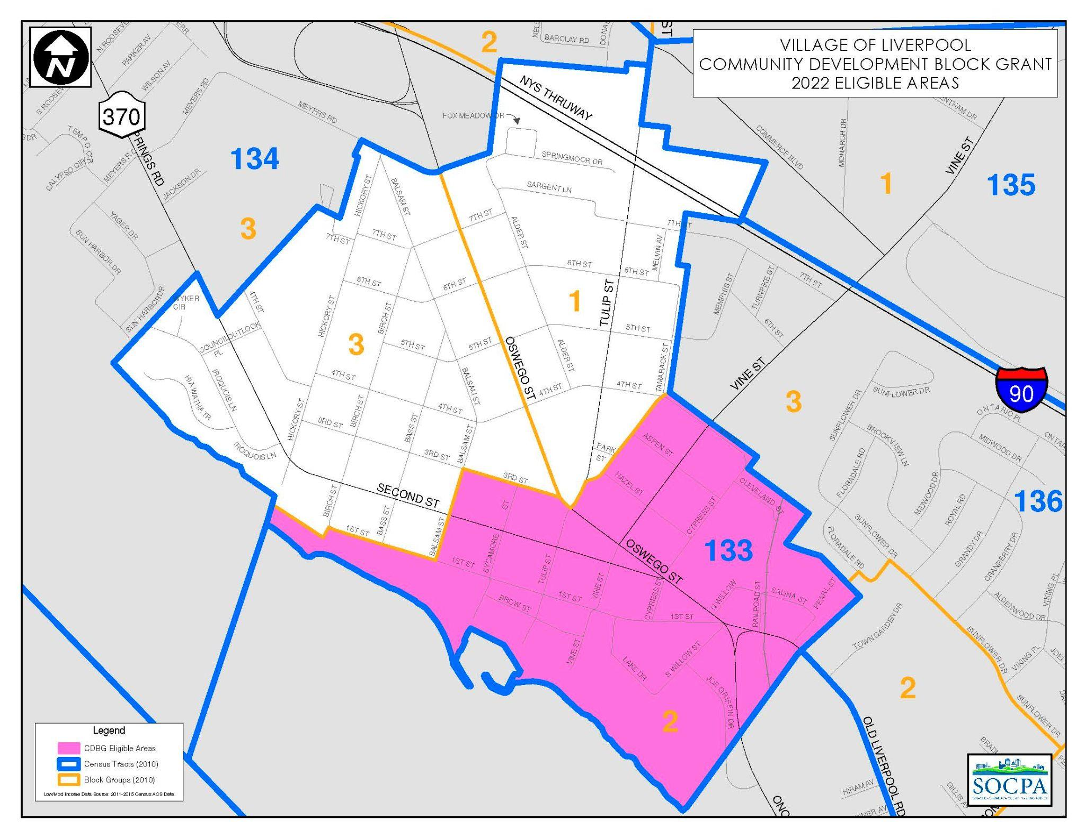
Management Plans & Future Planting
2021: Planted 9 trees throughout the Village by purchasing trees through CCE’s Annual Community Tree Buy; no volunteer events held due to COVID-19.
2022: Planted tree for Arbor Day; Plant 5-10 free trees from CCE in the Community Development Block Grant (CDBG) area in Fall; purchase another round of trees through the annual Community Tree Buy in Fall; planning for Fall volunteer events!
2023: Arbor Day planting, CDBG planting, annual Community Tree Buy purchase; Tree Steward program.
And so on!

Slide 6
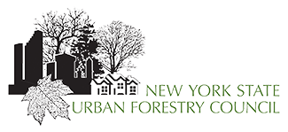
Partnerships
Onondaga County Soil & Water Conservation District
International Society of Arbioculture Tree Risk-Assessment Qualified (ISA-TRAQ) Arborist provides Phase 1 and Phase II Risk Assessments for potential problem trees
Recommends planting locations and identifies trees that need to be removed
Cornell Cooperative Extension of Onondaga County
Supports the CDBG-area plantings by providing free trees
Assists the Committee with the annual Community Tree Buy
Provides educational material and expertise for planting events
NYSDEC / NYS Urban Forestry Council
Allows the Committee to Participate in New York ReLeaf webinars to learn about planting initiatives and best management practices
Notes:
Change the ISA-certified arborist to the specific group who can provide the tree risk assessments and different levels

Slide 7
What is an ISA certified arborist?
A certified arborist is an individual who is trained in the art and science of planting and maintaining individual trees.
have a minimum of three years' full-time experience working in the professional tree care industry
follow a code of ethics to ensure the reliability of their work
and have passed an arboriculture exam or hold a degree in arboriculture, forestry, landscape architecture, or horticulture
After passing the exam, an ISA certification is only valid for three years. Arborists must maintain their certification by completing 30 continuing education units (CEUs) in that time.
Arborists that have the International Society of Arboriculture Tree Risk-Assessment Qualification (ISA-TRAQ) have a specialized knowledge of tree risk assessment. To earn the qualification, eligible candidates must complete a training course, and pass both a comprehensive written assessment and a performance-based assessment. To maintain the qualification, current credential holders must retrain and retest every five years.
Notes:
Tree risk assessment qualification – add these and who can complete them and how it is separate from certified arborists

Slide 8
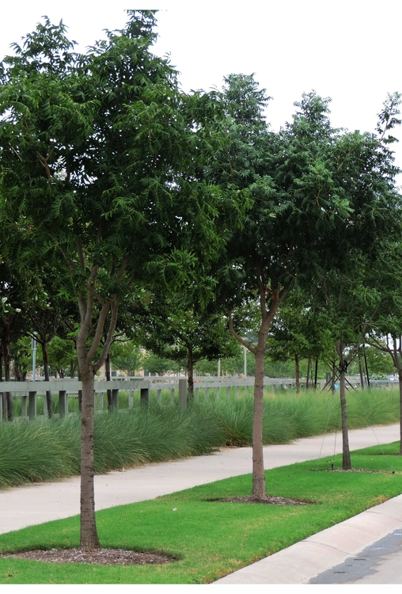
Community (Municipal) Trees
What is a municipal tree?
Any tree located on grounds owned, leased or otherwise controlled by the Village of Liverpool for public use.
Where are municipal trees located?
Parks, cemeteries, and within public right-of-ways (ROW).
How do you know if a tree is located in a public ROW?
The simplest answer is trees located between the sidewalk and the street are located in the ROW and are municipal trees.
There are some streets that don’t have sidewalks and there are some trees that are municipal trees that are located on the home-side of the sidewalk.
If you have a question about a tree on or near your own property, the easiest thing to do is to check the land survey for your property.
Notes:
ROW definition in the Village code? Check and see if it’s defined in our zoning in the Village; the map that Bill keeps shows all Village trees

Slide 9
How Can I Help? Become a Tree Steward!
Help with the care for the first year of newly planted municipal trees adjacent to their property.
Watering – frequent watering during the growing season for the first year, especially during dry spells
Mulching – Mulch should be kept at least three inches away from the base of the trunk and should be no more than 3-5 inches deep
Protection – Protect the tree including the truck from mowing, weed-whacking, snow removal, or other damage
No flowers or other plants should be planted around the base of the tree for the first 2 years
Help keep an eye on established municipal trees (parks, cemetery, ROW, etc.). Call the Village office if you have a concern or would like an Arborist’s opinion on a tree.
Volunteer to help with planting efforts.
Help identify tree planting locations—if you want a tree, please let us know! We will work to find a plantable location in your neighborhood.
Cornell Cooperative Extension provides a CommuniTree Steward training annually. This is a free training in tree biology, tree identification, and tree planting and maintenance for young trees.
Notes:
Identification of tree planting locations. If you want a tree please call us!

Slide 10
Potential Signs a Community Tree Risk Assessment
Storm damage – from wind, lightening, etc.
Visible rot
Dropping large limbs
Damage to the bark or other parts of the tree
A large portion of the tree branches bare during the growing season
Signs of pest infestation or damage, or disease

Slide 11
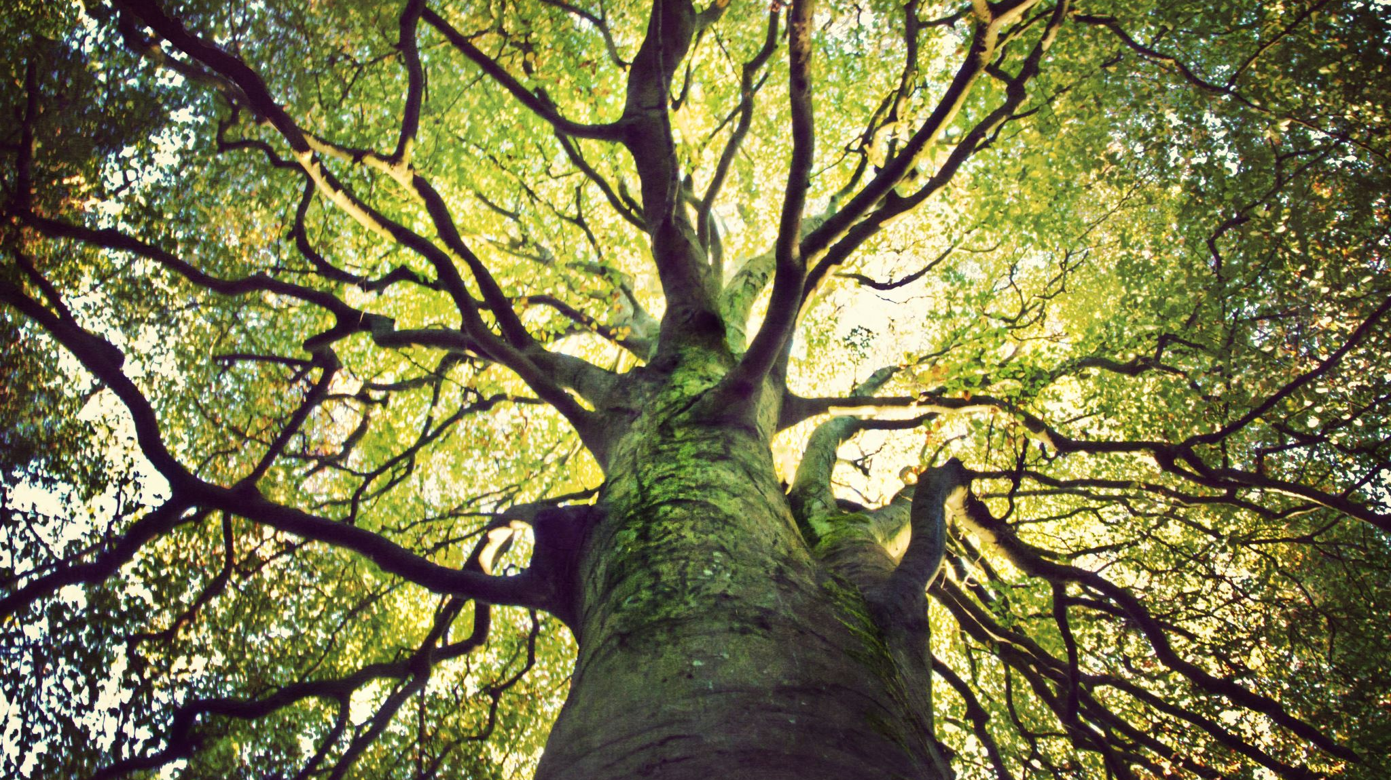
If You Think A Community Tree May Need Care…
Call the village office (315-457-3441) with the location of tree and why the tree may need assessment.
When you call about a tree, please know that it can take time for it to be assessed and any potential action to be taken.
It may be determined that it doesn’t need care or doesn’t need care at this time and is then potentially added to the watch list.
It may be added to a list for pruning or removal. The village DPW usually collects a list of trees that need service or removal and then puts a call in for a tree company to come out. If there is an immediate danger, the tree will be serviced as soon as possible.

Slide 12
Moving Forward - How To Stay In Touch
The Village of Liverpool Tree Committee meets at 7PM on the 2nd Monday of every month.
Location: Village Hall, 310 Sycamore Street, Liverpool, NY 13088
Keep an eye out for your community trees. If you see a tree within the ROW that may need a risk assessment, please let us know by calling us at
315-457-3441
You can also reach out to the Village via email at villageclerk@villageofliverpool.org.
You can find DPW Service Request forms on the Village of Liverpool website.

